Slide 1







ACCOUNTING RECREATIONAL CLUB
F
R
E
S
H

Slide 2


PART 01
2021 ARC Committee

Slide 3

President | Wilson Ting Chung Kik
Vice President | Kavin Ling Chee Hoe
Secretary | Tang Xue Rou
Treasurer | Chua Teck Hua
Auditor | Stephen Chiew Chung Han
Event Coordinator | Tan Yuh Shiow, Brandy Sia Siew Ting, Ting Yiann Yii, Joyce Ngua Han
Public Relation | Wong Hoi Siek, Lee Meei Shien
Photographer | Doreen Tang Swee Lieng
Advisor | Madam Angela Tiong

Slide 4
PART 02
Mission and Vision

Slide 5


Foster keen interest in studies
A platform for interactions between students and lecturers
A platform for practical of management skill
Provide outside classroom learning

Slide 6
PART 03
Membership

Slide 7


The membership fee is payable once for the lifetime as MPI student
All members shall be entitled to all rights and privileges of this club, such as:
Voting in Annual General Meeting (AGM)
Become committee member

Slide 8
PART 04
Event

Slide 9


At least one event in every single semester
EAB point will be provided
Membership fee: RM10 (once for lifetime)
Registration fee: RM10 (every event)

Slide 10
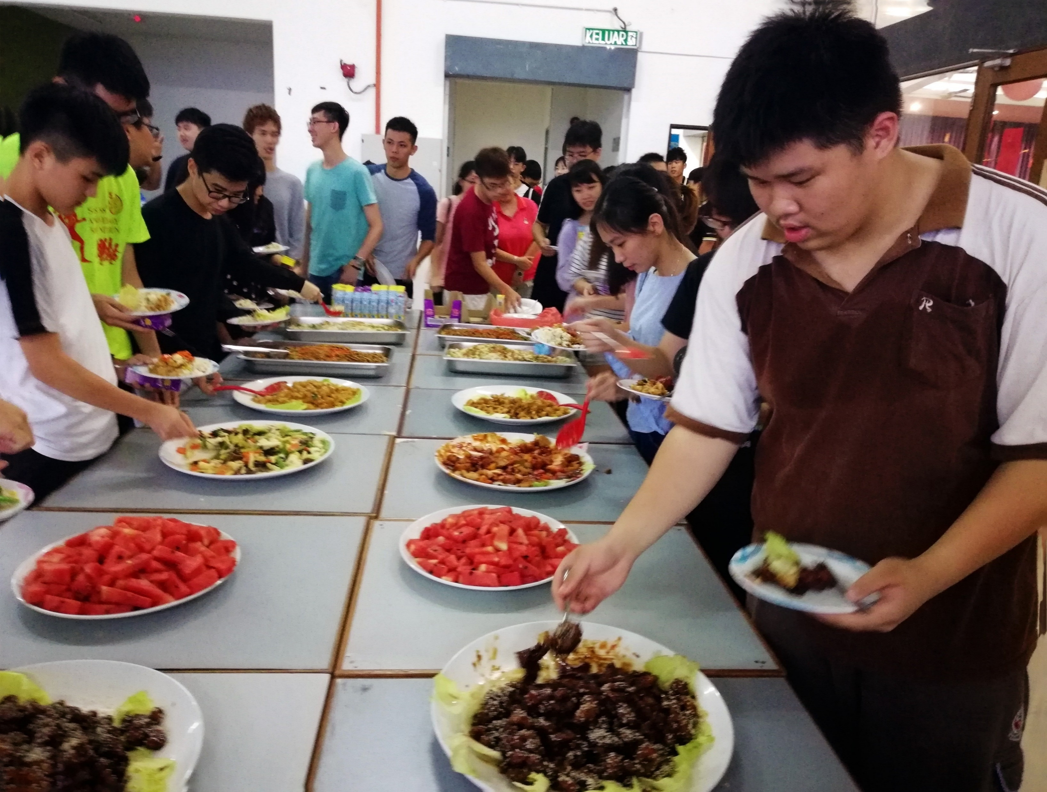
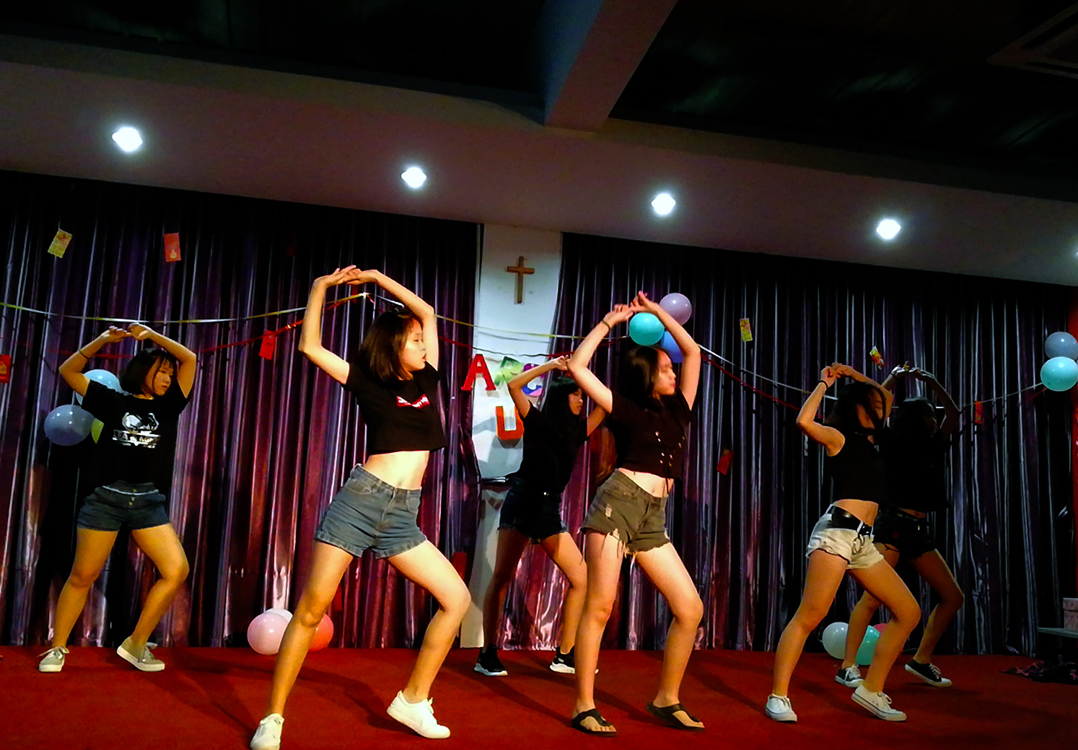
Chinese New Year Event 2019

Slide 11
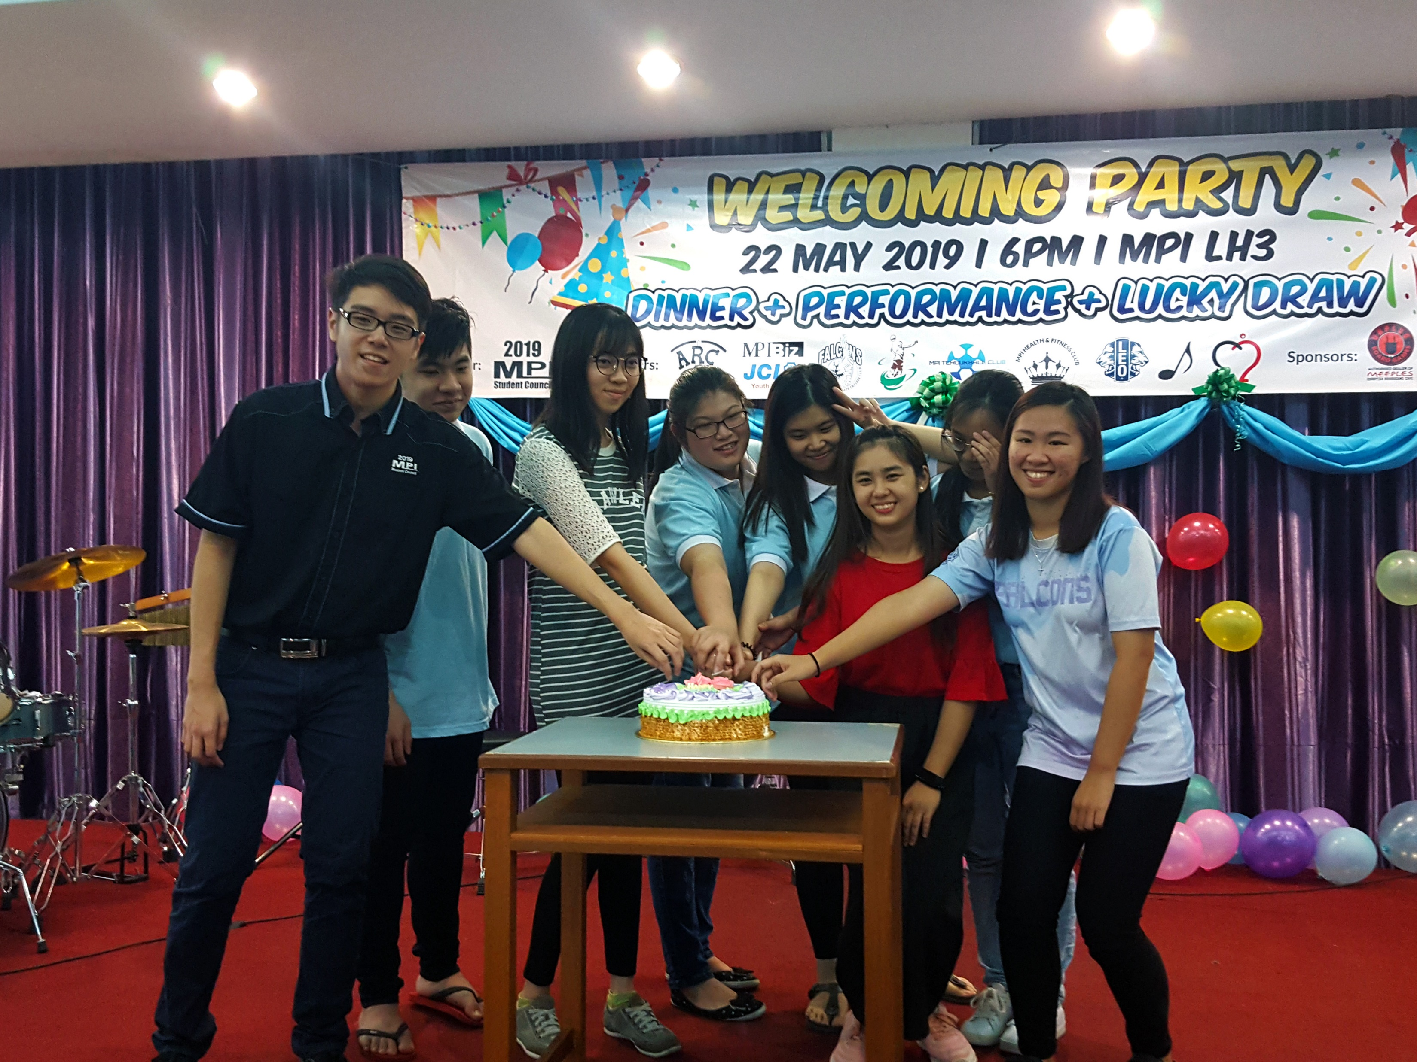
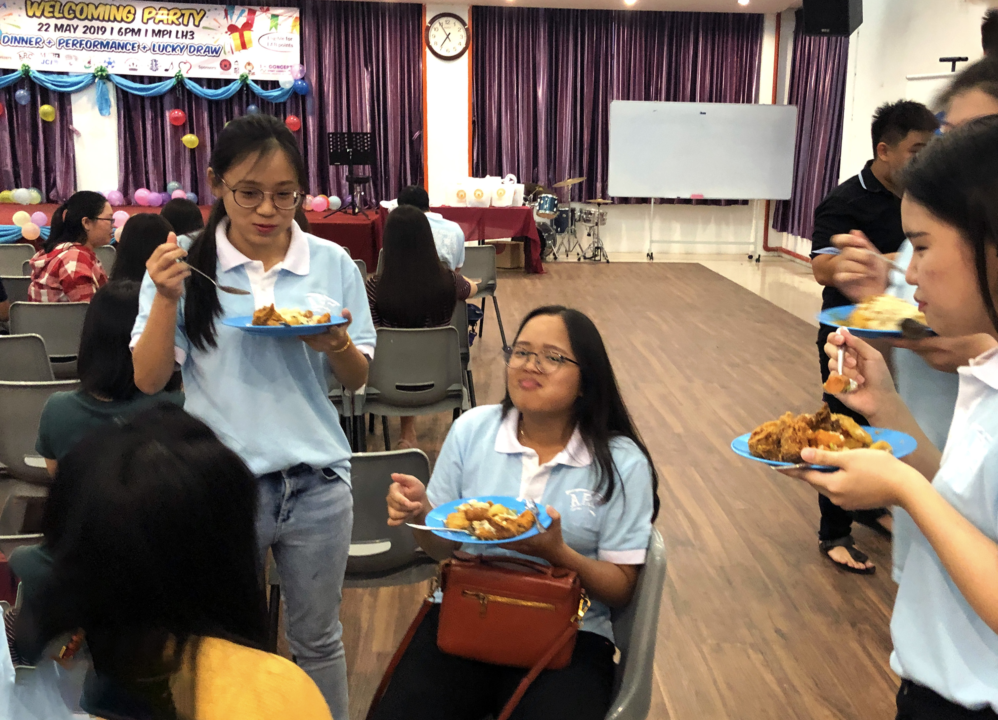
Welcoming Party 2019

Slide 12
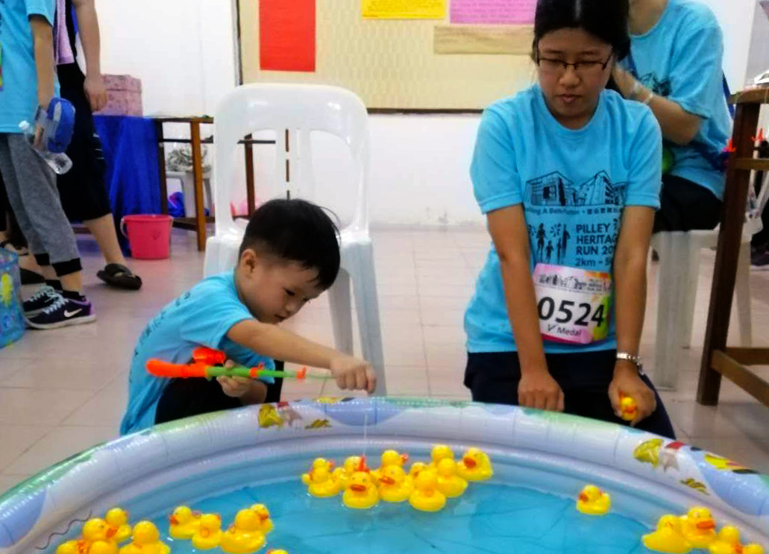
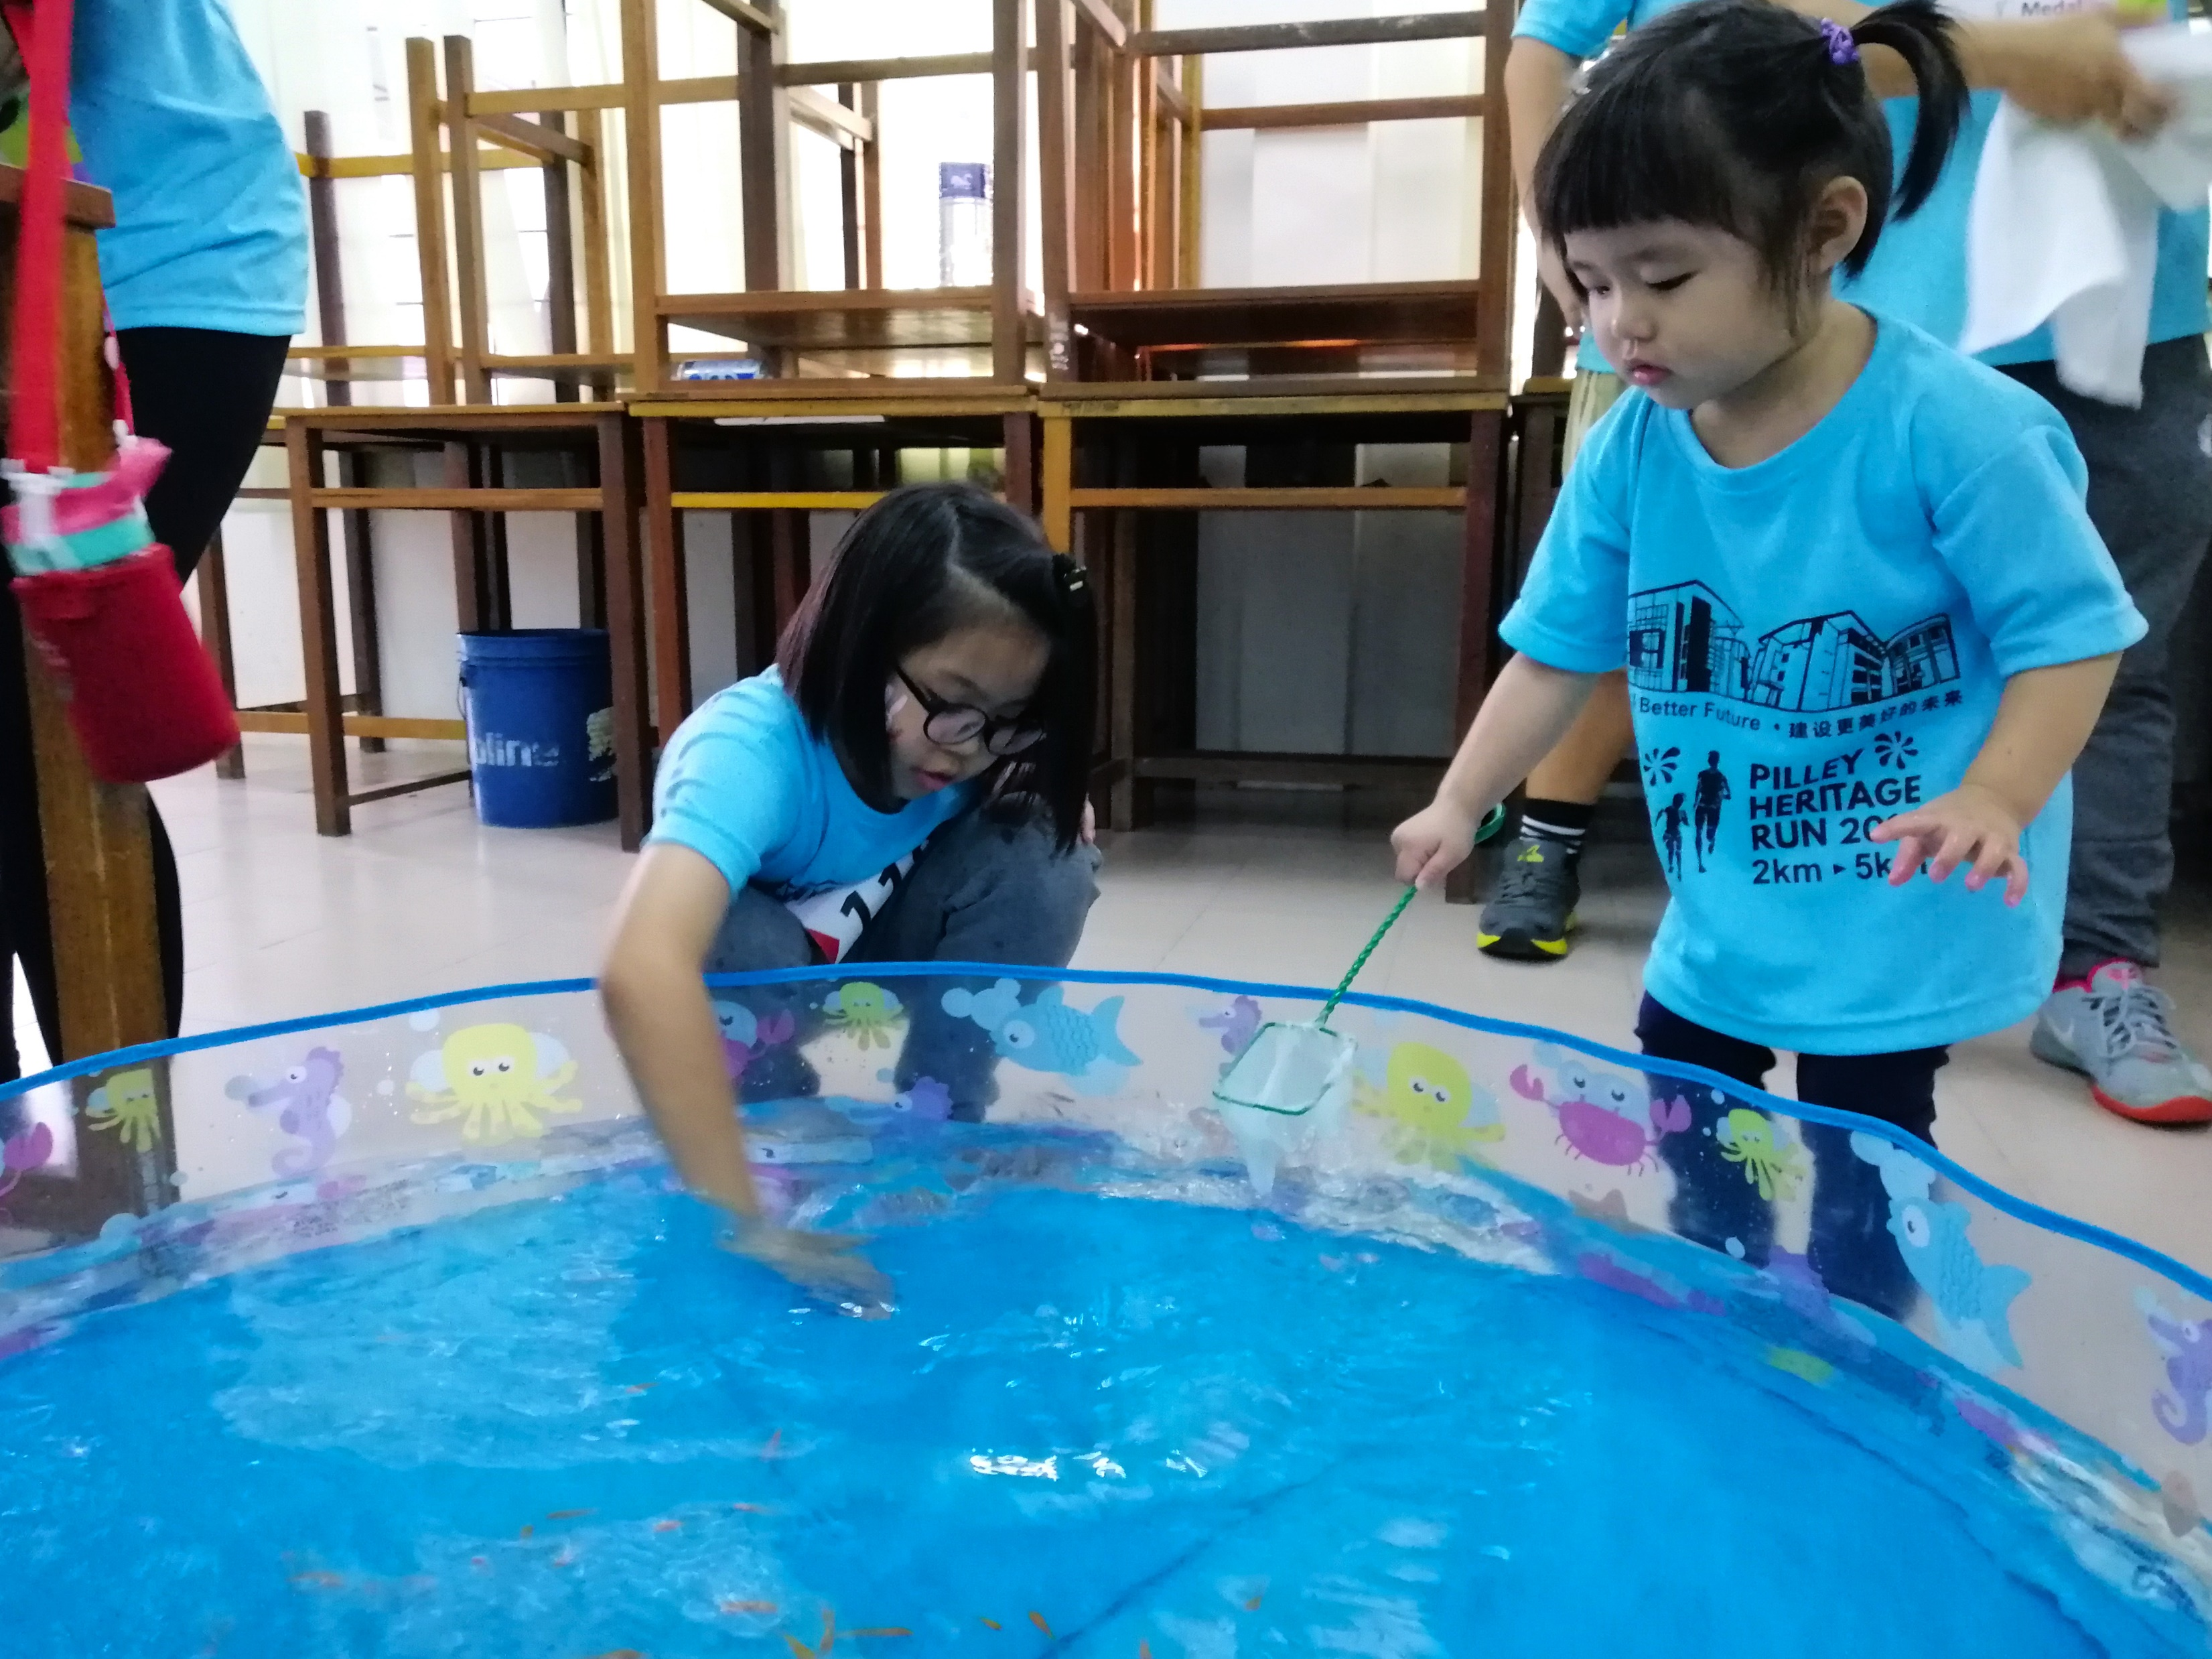
Marathon Festival 2019

Slide 13
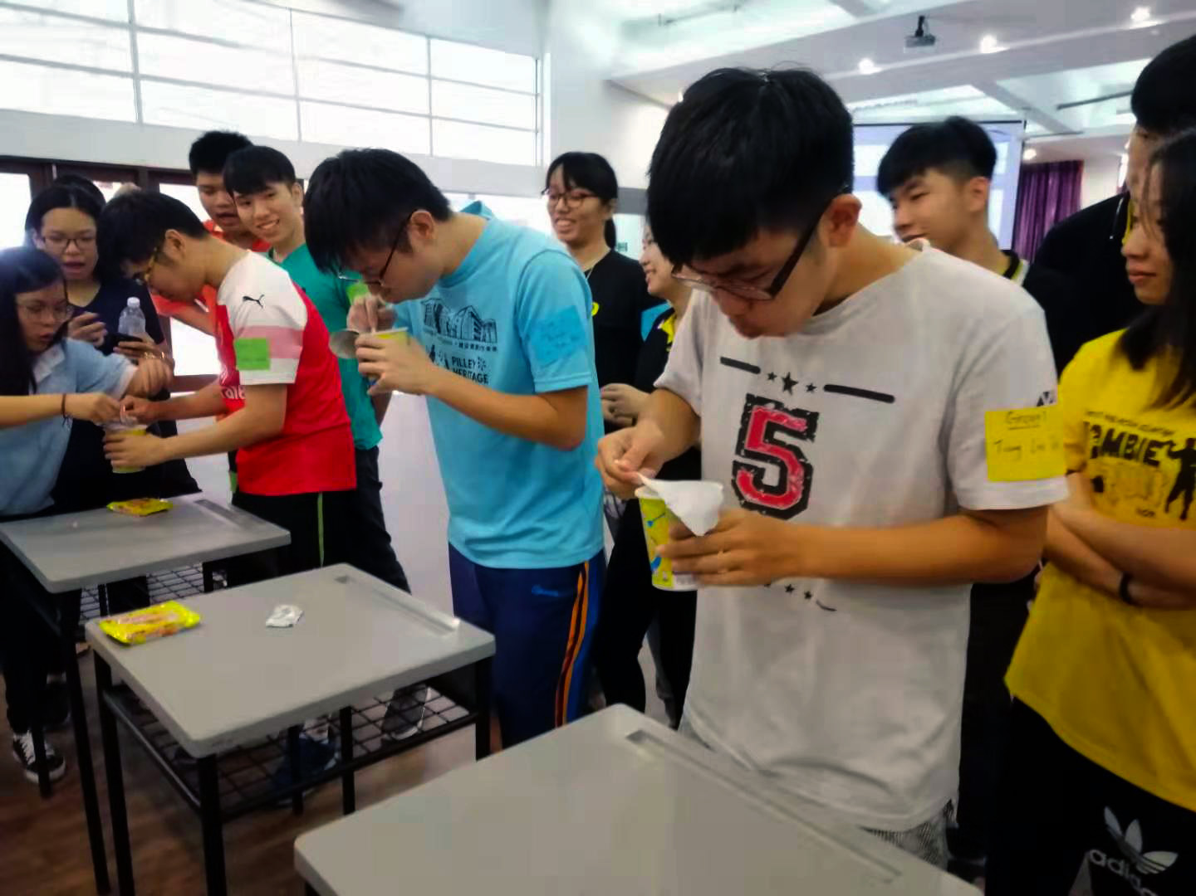
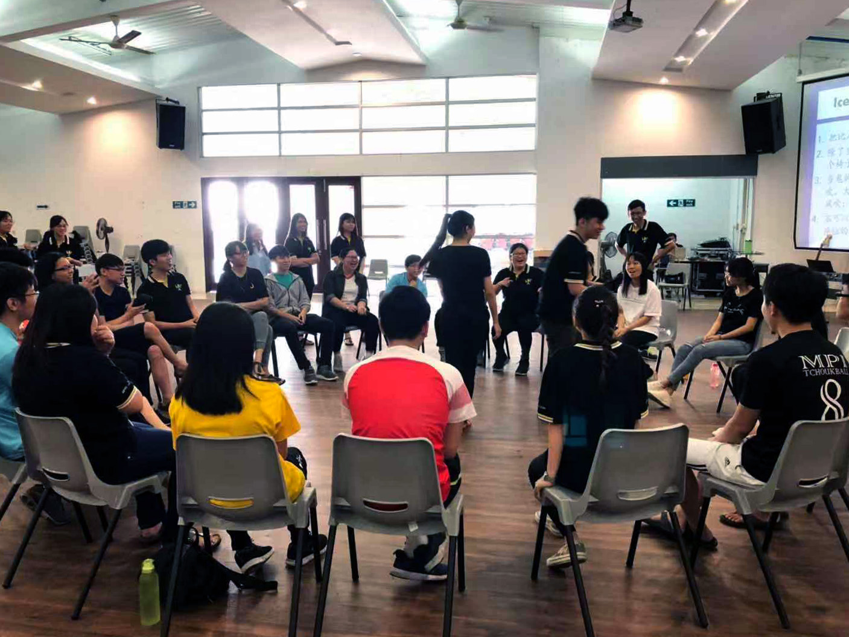
Mooncake Running Festival 3.0

Slide 14
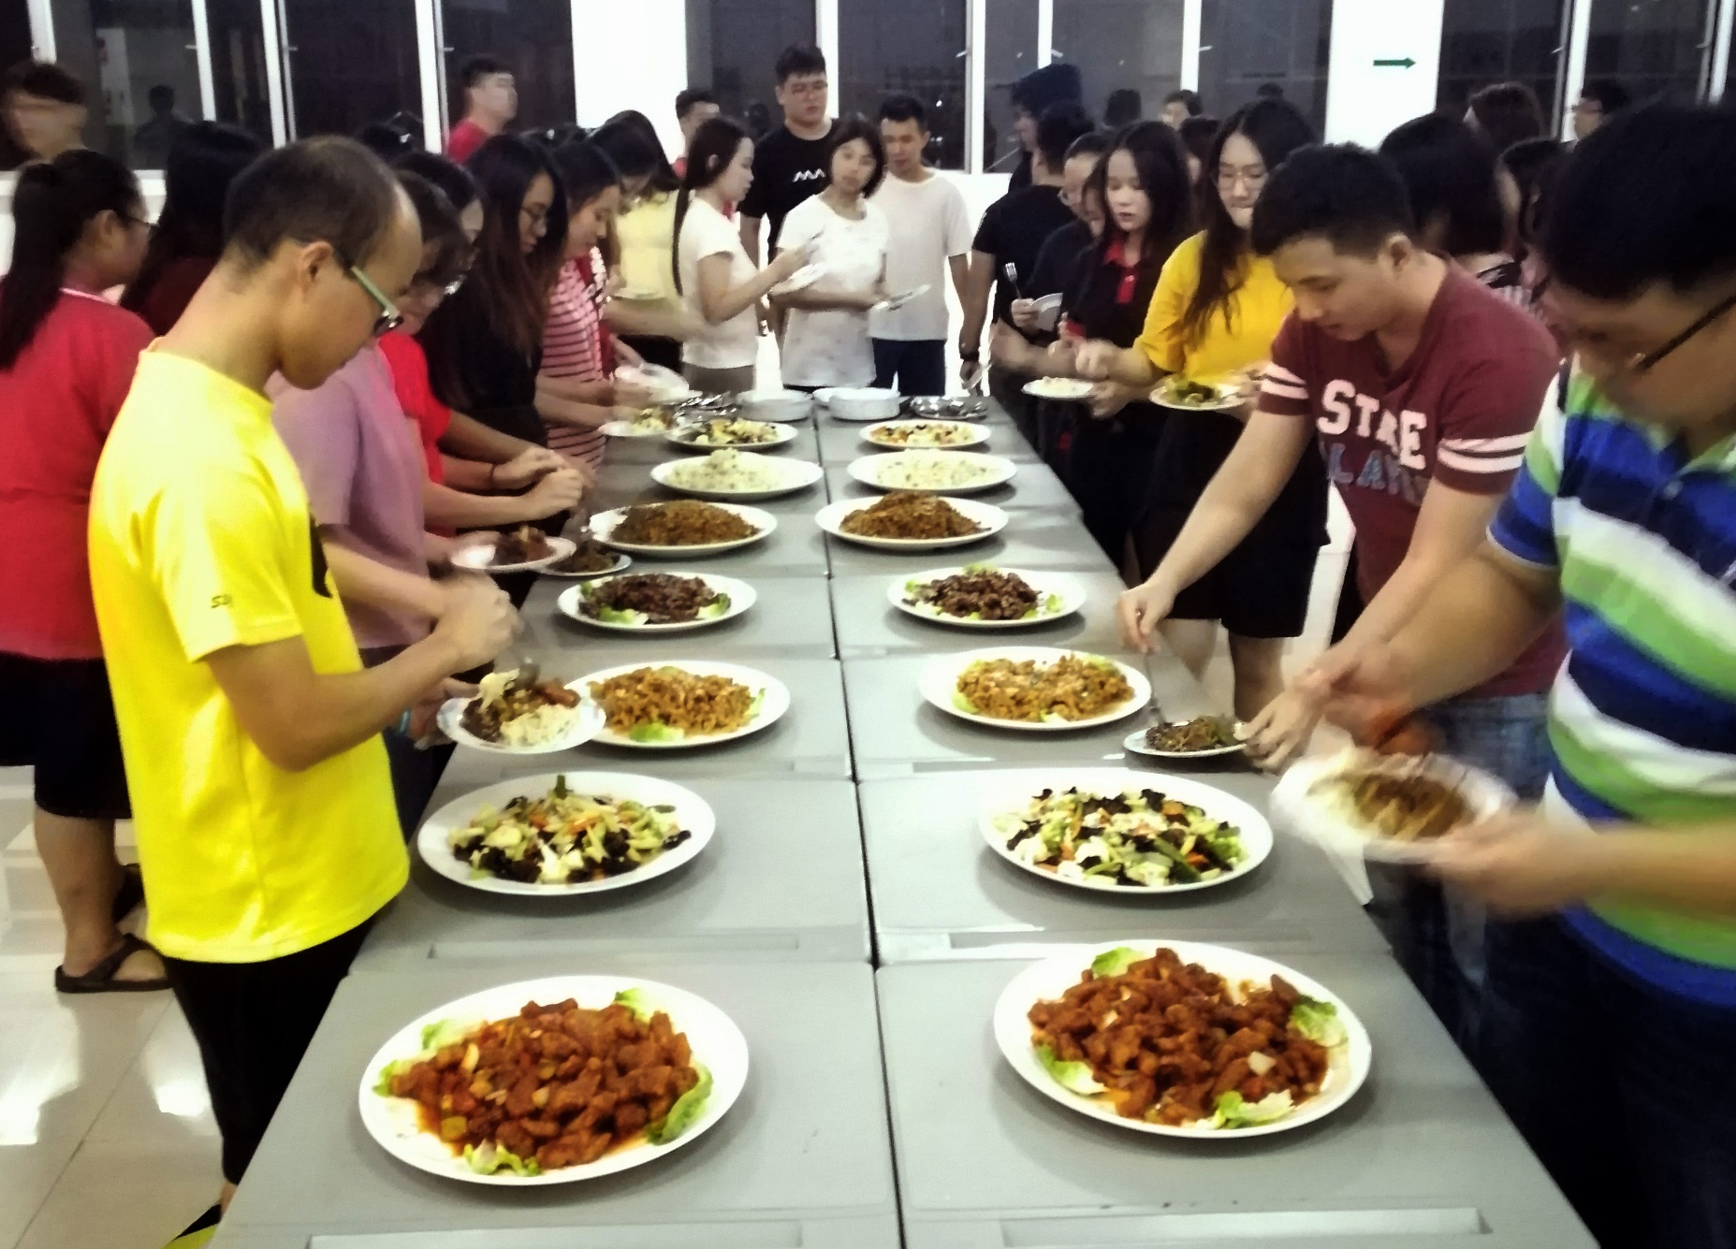
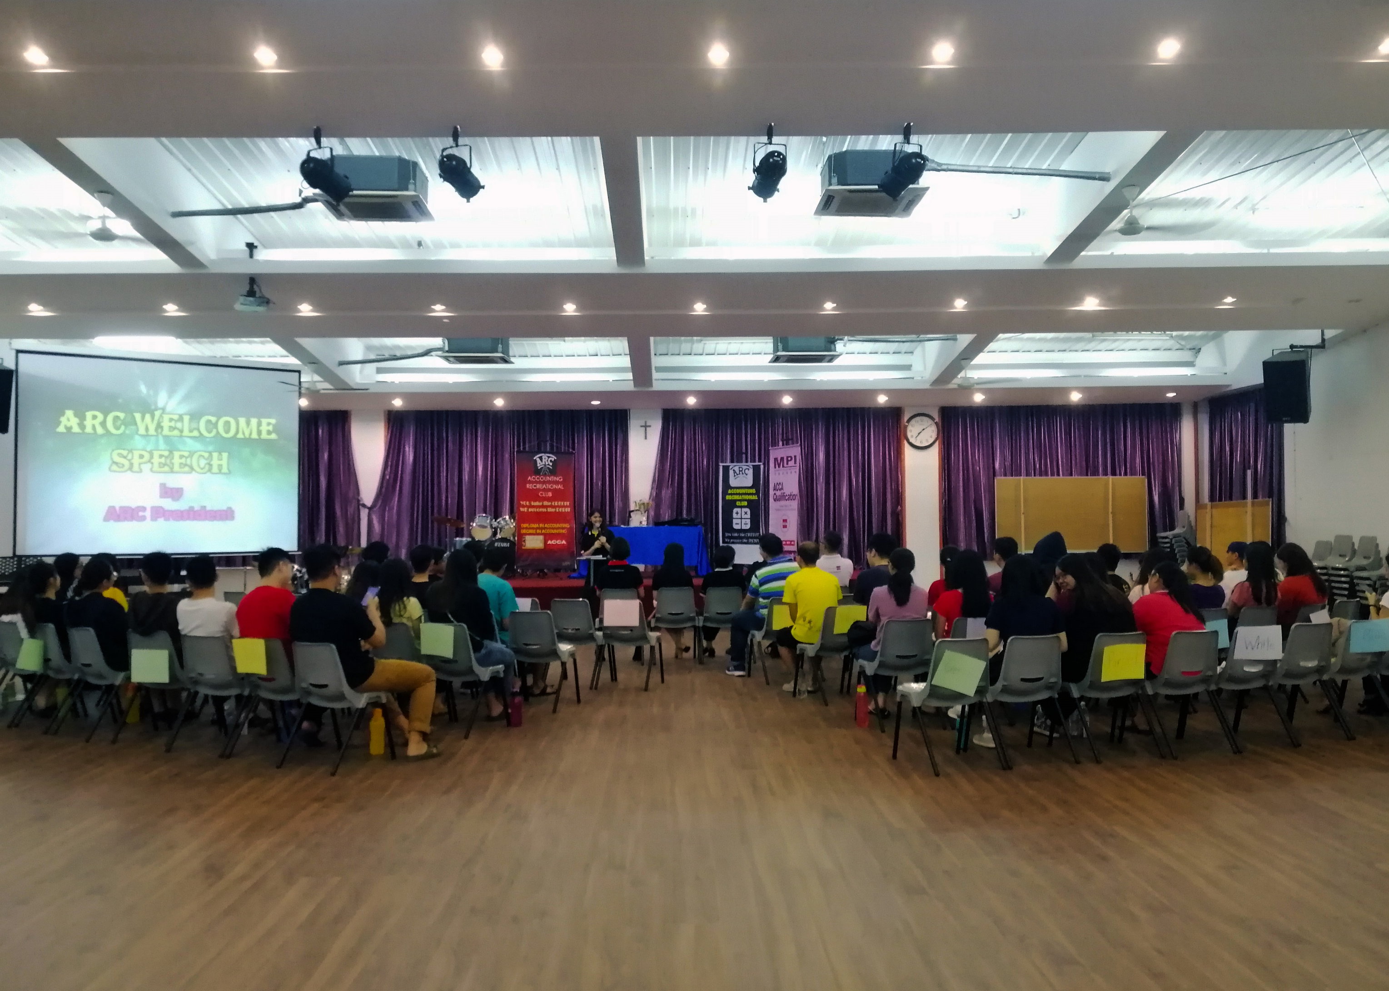
AGM Night 2019

Slide 15
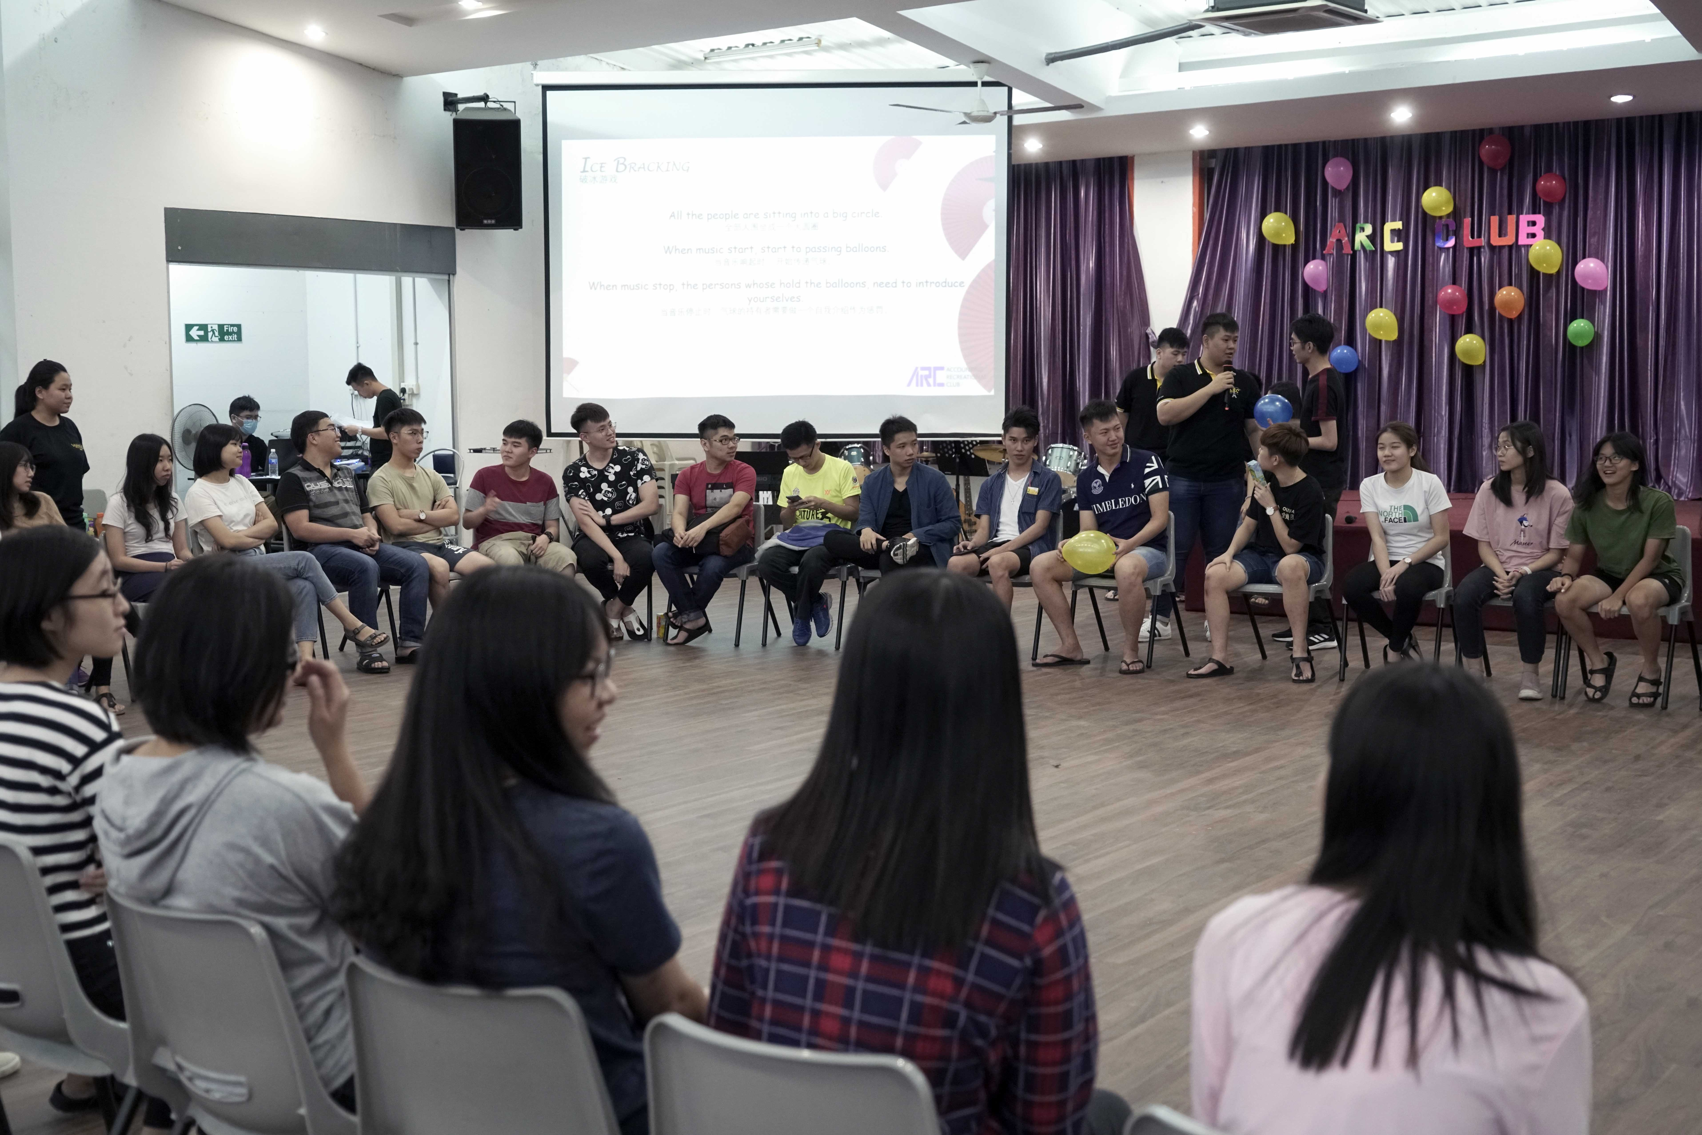
Lunar New Year Party 2020

Slide 16
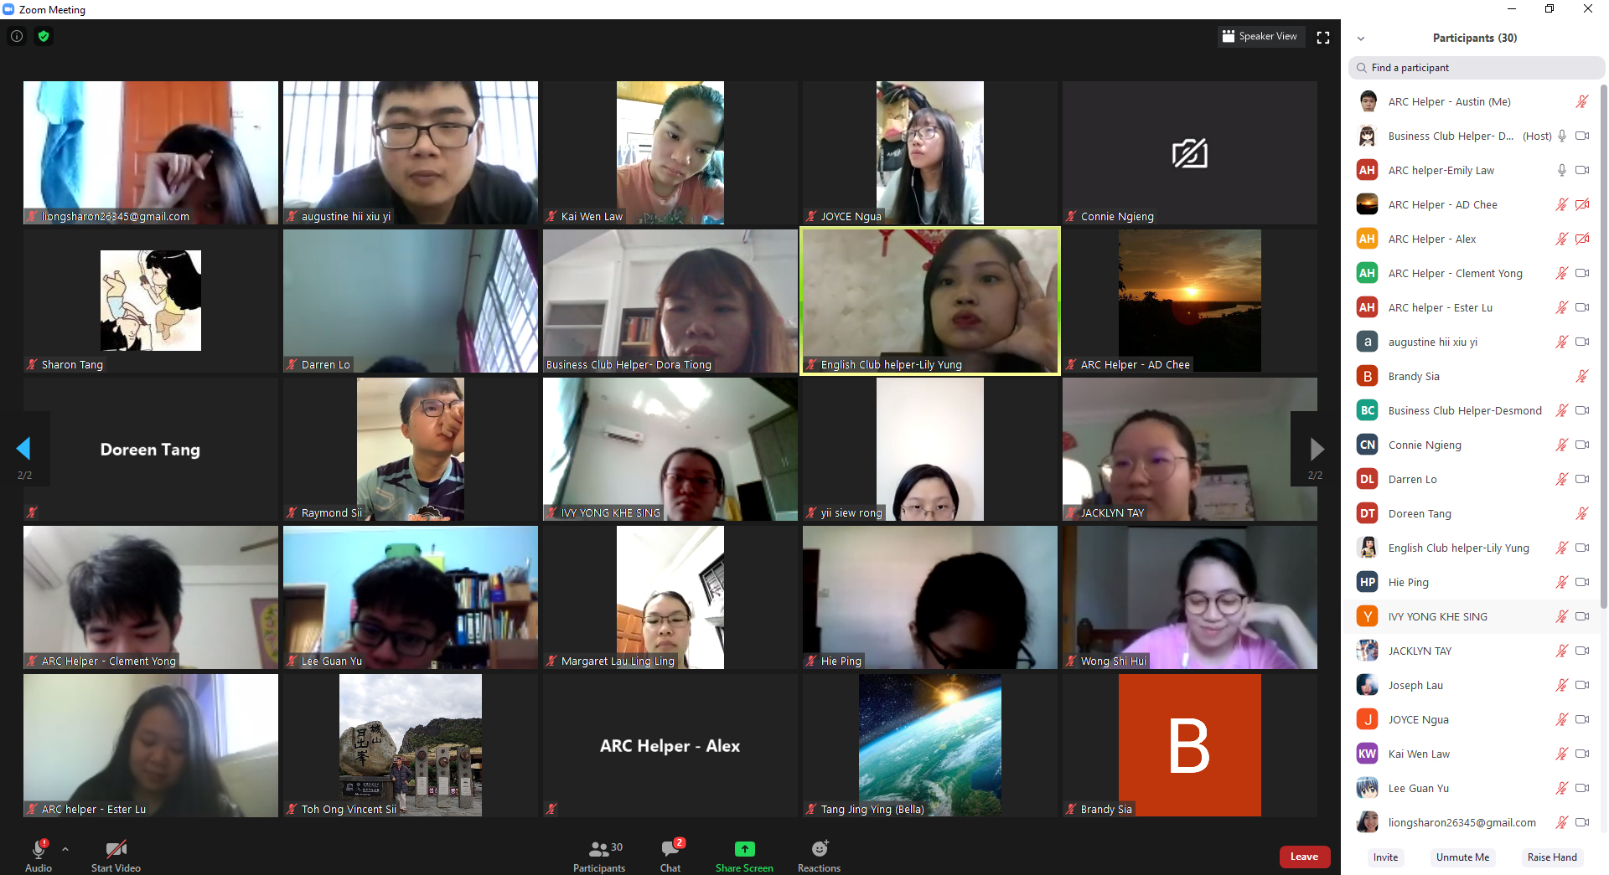
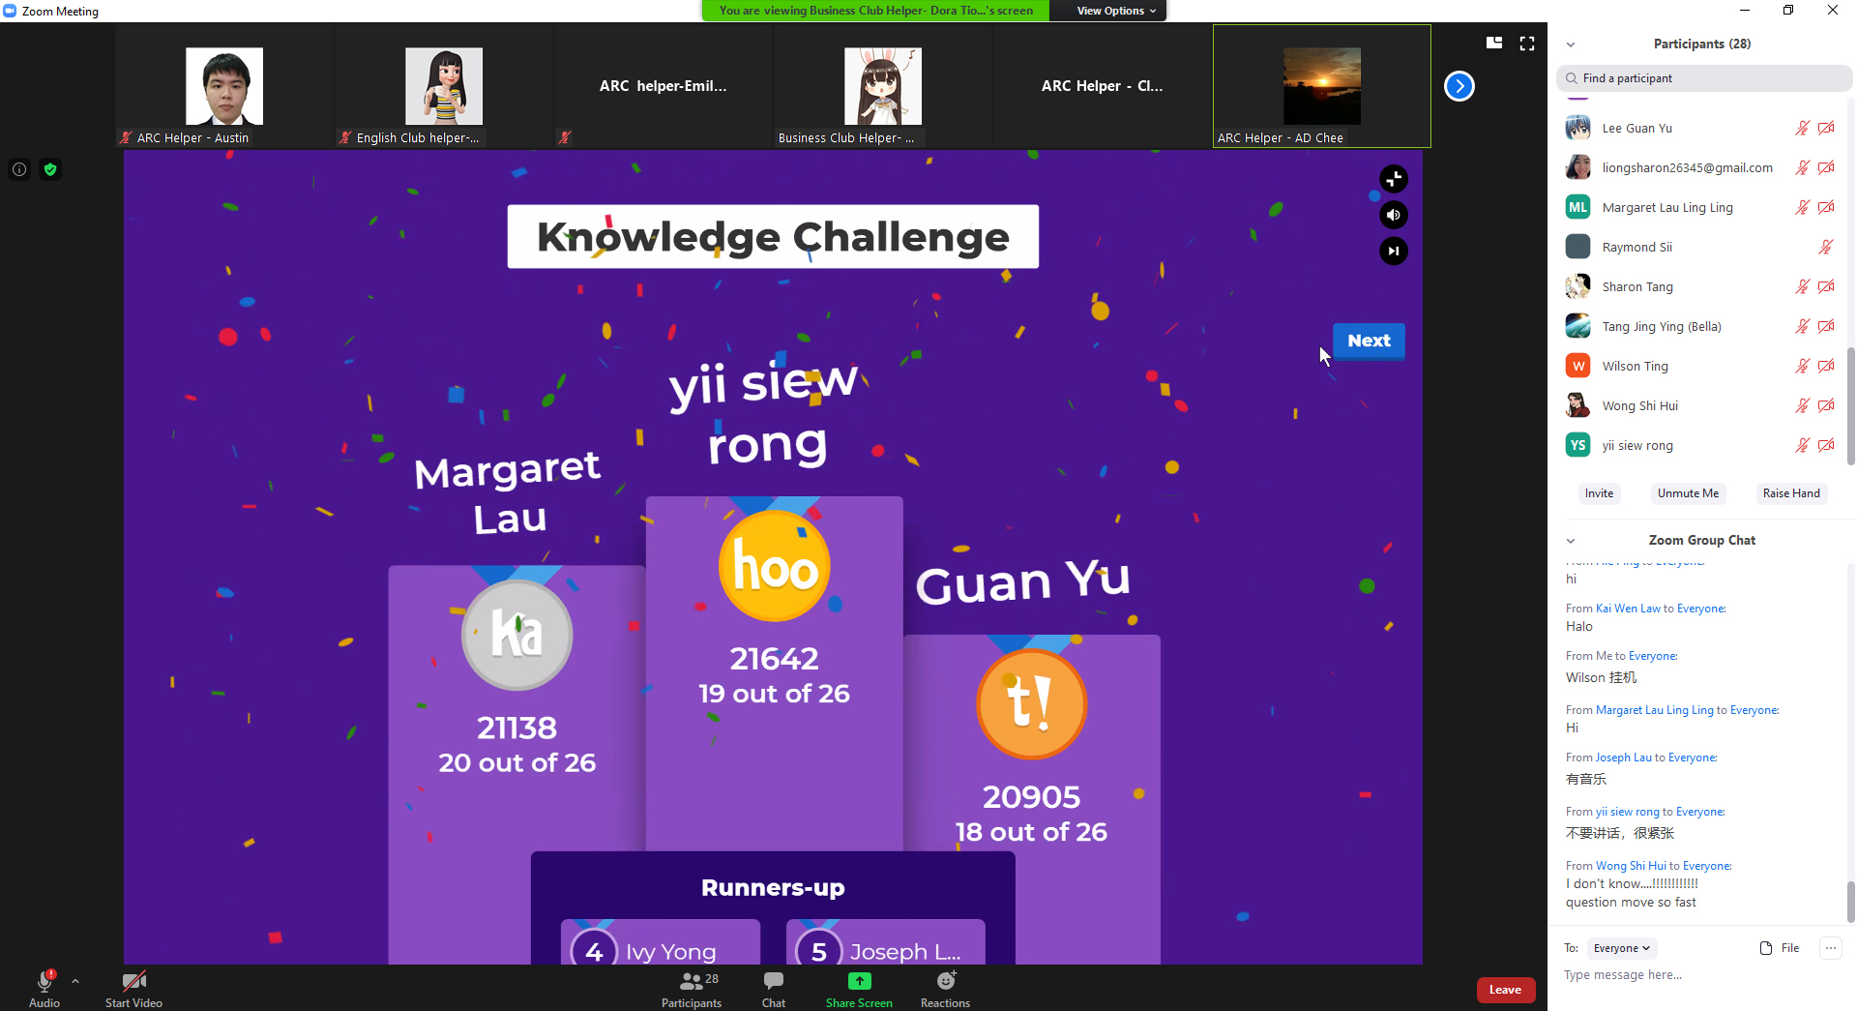
Stay Home Stay Together Stay Connect 2021

Slide 17
PART 05
Social Media

Slide 18
Google Search
Accounting Recreational Club
OR
https://arc20.github.io/mpi/index.html

Slide 19
Thank You
F
R
E
S
H

